Slide 1
Some Continuous Probability Distributions
Asmaa Yaseen

Slide 2
Review from Math 727
Convergence of Random Variables
The almost sure convergence
The sequence converges to almost surely denoted by , if

Slide 3
Review from Math 727
The convergence in Probability
The sequence converges to X in probability denoted by , if

Slide 4
Review from Math 727
Quadratic Mean Convergence
Almost Sure Convergence
Convergence in
Uniform integrability
Convergence in probability
Constant limit
Convergence in distribution

Slide 5
Review from Math 727
Let be a sequence of independent and identically distributed random variables, each having a mean and standard deviation . Define a new variable
Then, as , the sample mean X equals the population mean of each variable

Slide 6
Review from Math 727

Slide 7
Review from Math 727
In addition

Slide 8
Review from Math 727
Therefore, by the Chebyshev inequality, for all ,
As , it then follows that

Slide 9
Gamma, Chi-Squared ,Beta Distribution
Gamma Distribution
The Gamma Function
for
The continuous random variable X has a gamma distribution, with parameters α and β, if its density function is given by
0,
Otherwise

Slide 10
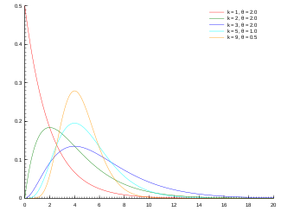
Gamma, Chi-Squared ,Beta Distribution
Gamma’s Probability density function

Slide 11
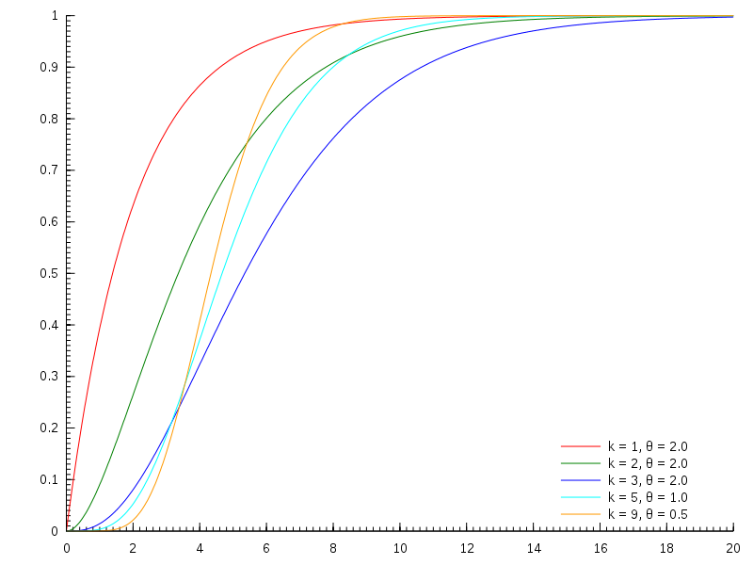
Gamma, Chi-Squared ,Beta Distribution
Gamma Cumulative distribution function

Slide 12
Gamma, Chi-Squared ,Beta Distribution
The mean and variance of the gamma distribution are :

Slide 13
Gamma, Chi-Squared ,Beta Distribution
The Chi- Squared Distribution
The continuous random variable X has a chi-squared distribution with v degree of freedom, if its density function is given by
Elsewhere ,

Slide 14
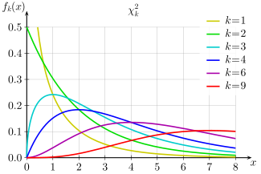
Gamma, Chi-Squared ,Beta Distribution

Slide 15
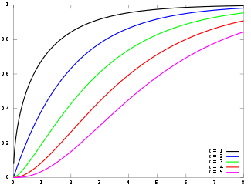
Gamma, Chi-Squared ,Beta Distribution

Slide 16
Gamma, Chi-Squared ,Beta Distribution
The mean and variance of the chi-squared distribution are
Beta Distribution
It an extension to the uniform distribution and the continuous random variable X has a beta distribution with parameters and

Slide 17
Gamma, Chi-Squared ,Beta Distribution
If its density function is given by
The mean and variance of a beta distribution with parameters α and β are

Slide 18
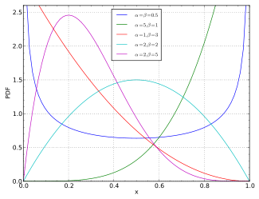
Gamma, Chi-Squared ,Beta Distribution

Slide 19
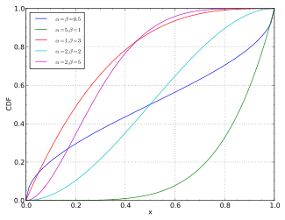
Gamma, Chi-Squared ,Beta Distribution

